Slide 1
Unveiling Chennai's Real Estate Market: Analysis & Prediction of House Prices
Name of the Candidates : Karthi M
Chandrakant Yeshi
Omkar Madkholkar
Srikanta Panda
Name of the Supervisor : Dr. Vinaya Kulkarni
with Designation Prof. Bhupesh Daheria

Slide 2
Introduction
Unlock the future of Chennai City's real estate market with our advanced house price prediction analysis.
Gain insights, make informed decisions, and stay ahead in the dynamic world of property investment.
Our cutting-edge project leverages data-driven methodologies, machine learning algorithms provide you with precise prediction.
Our project gives data-driven predictions for Chennai's real estate market, helping stakeholders make informed decisions and stay competitive in this dynamic industry.

Slide 3
Objectives
To create a Decision Tree-based machine learning model for predicting future property prices and providing recommendations for various types of residences, including flats and penthouses.
To develop a website and to show the results and suggestions to users.

Slide 4
Data Exploration
Dataset have been scraped from realesate.com website by using selenium.
Size of the data is 4044 rows ,15 columns.
Features : location, bedrooms, Bathrooms ,area, carpet area, super area, ownership, sale type, age of the property, plot type, floor, Furnishing, Status, Facing, price.

Slide 5
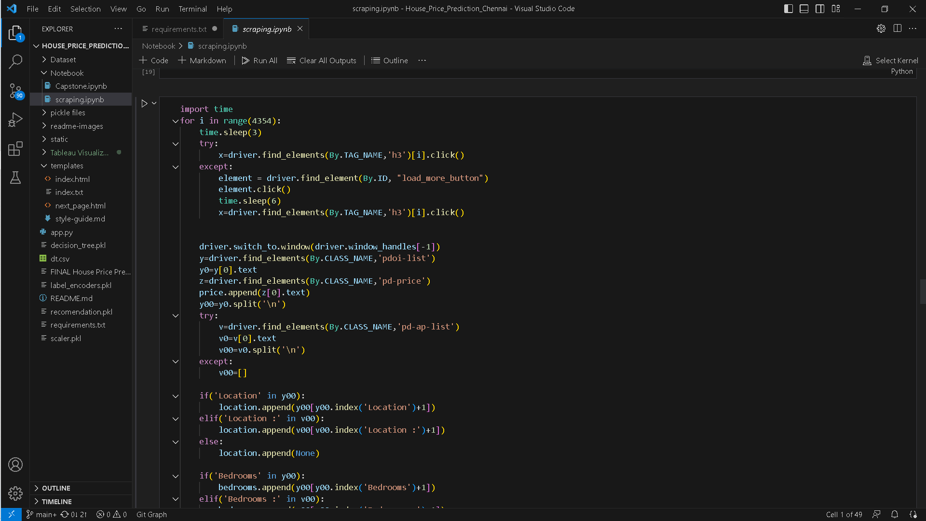
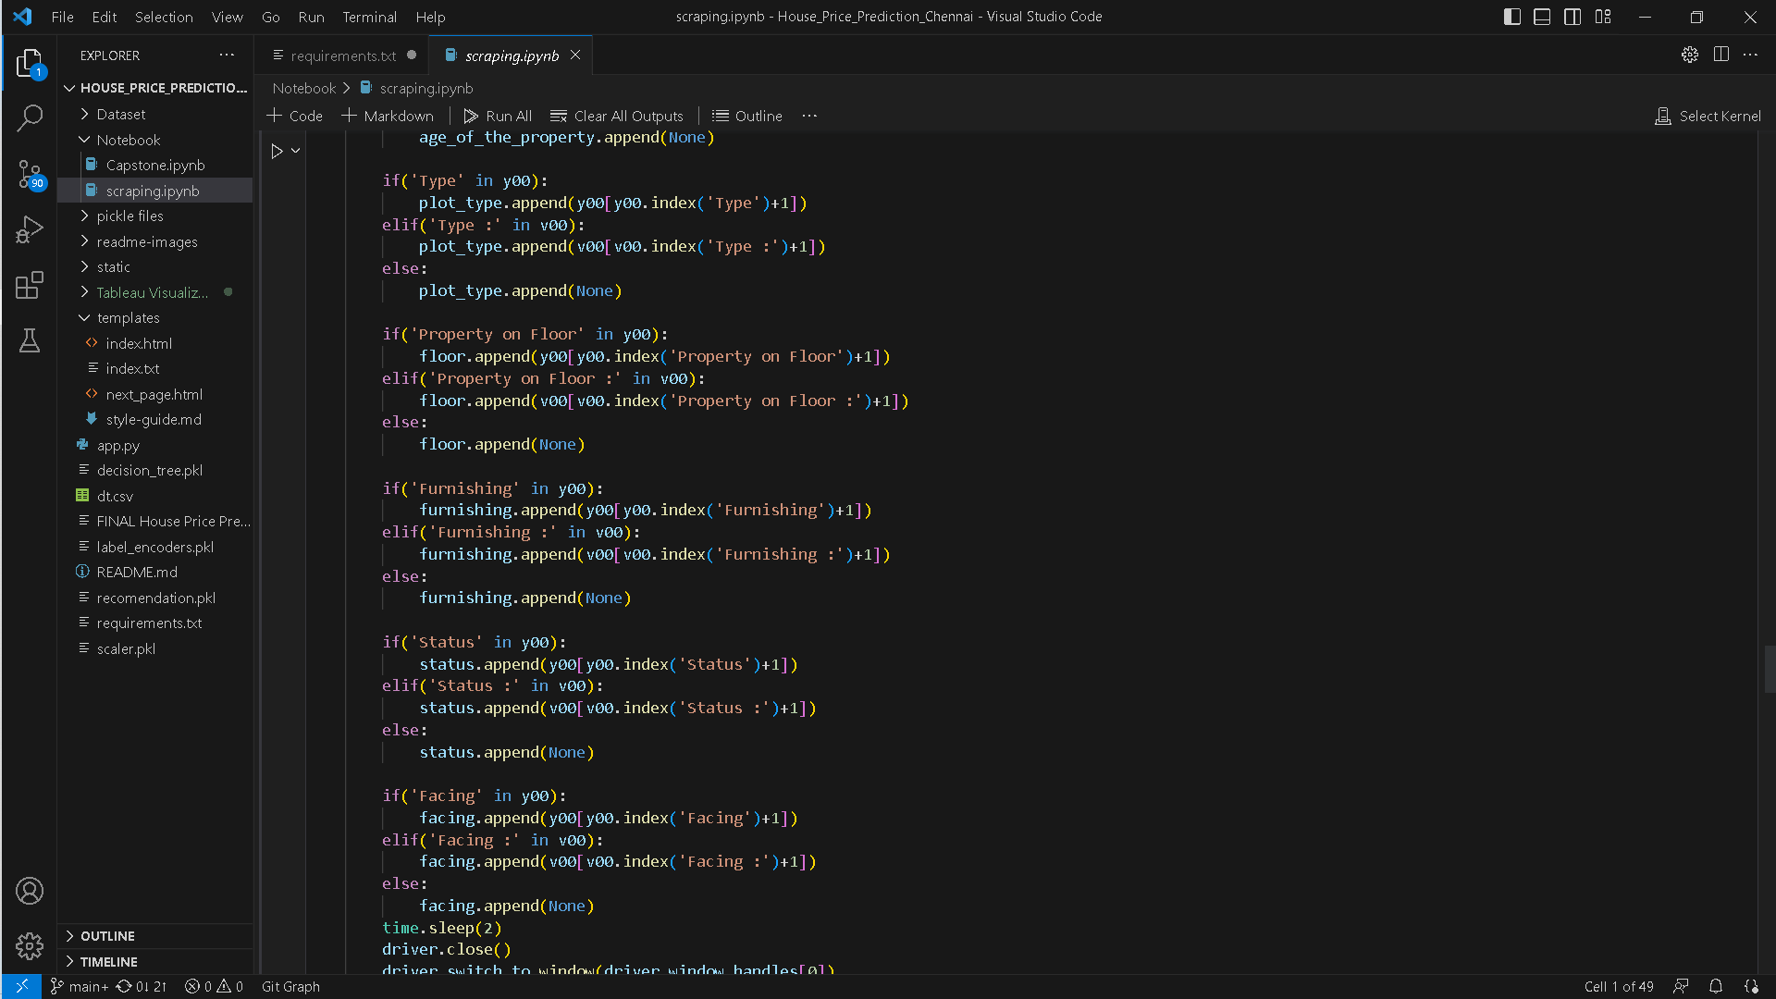
Data Exploration
Data Scraping

Slide 6
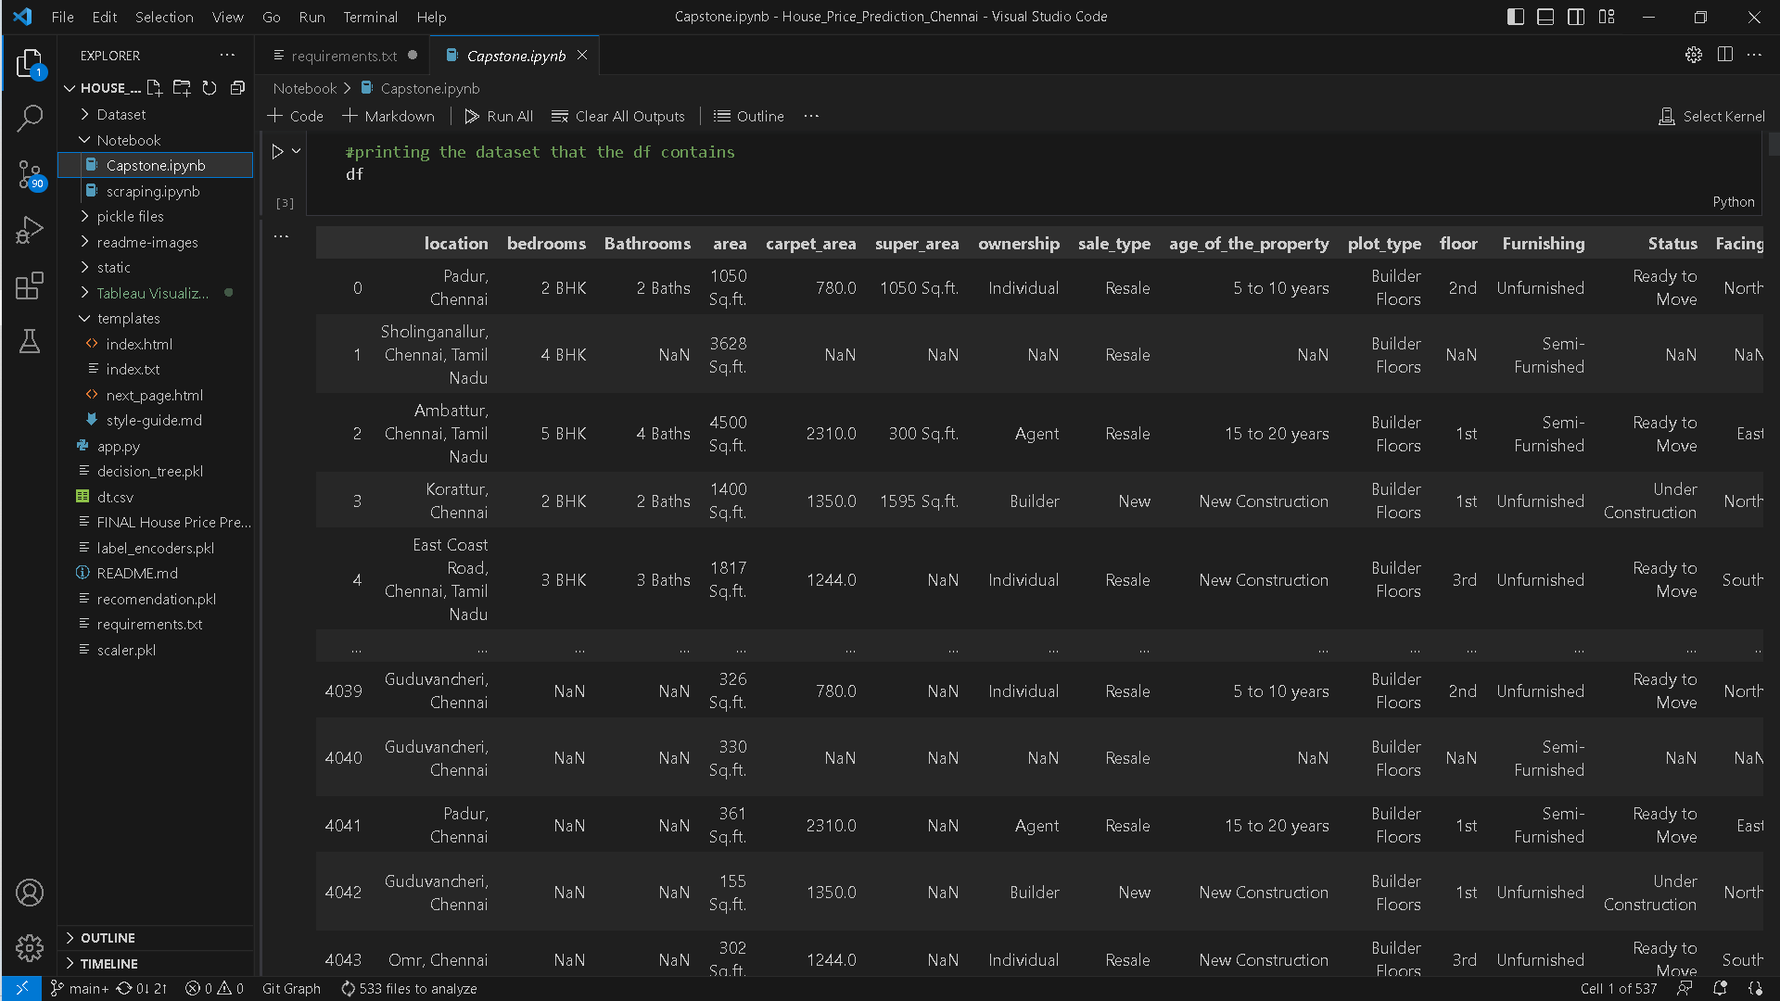
Data Exploration
Dataset

Slide 7
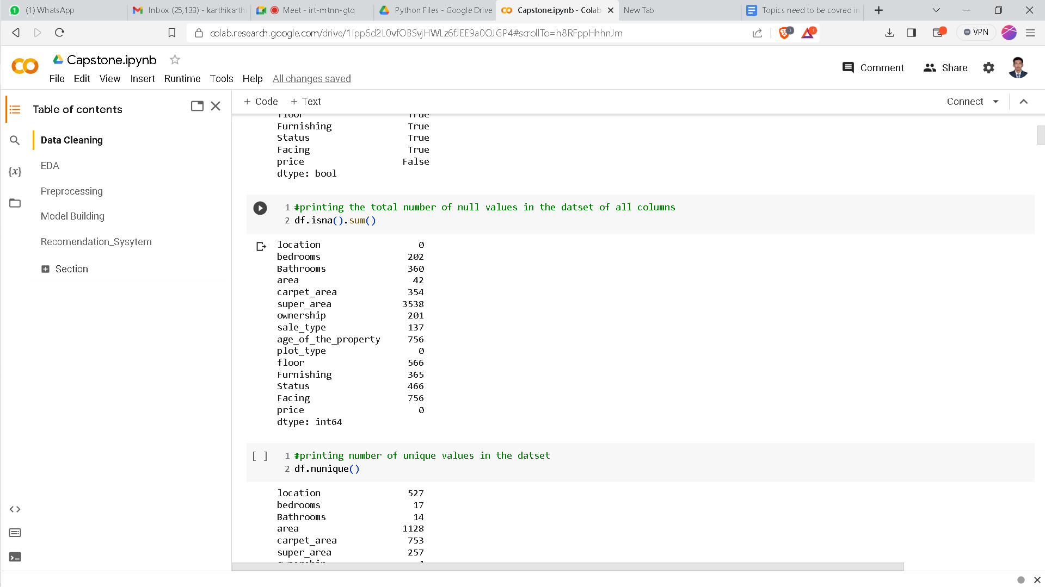
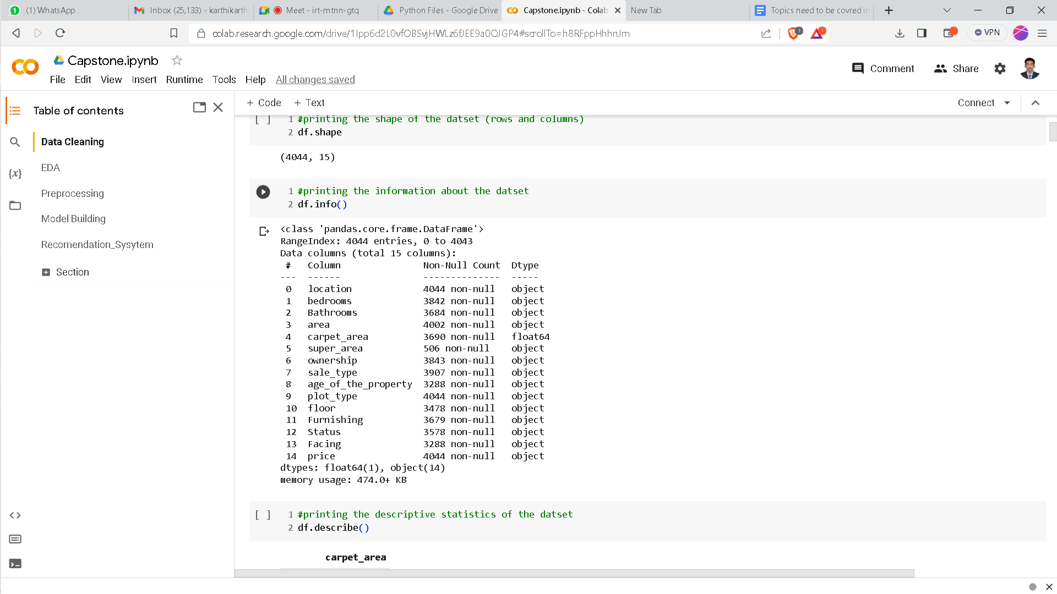
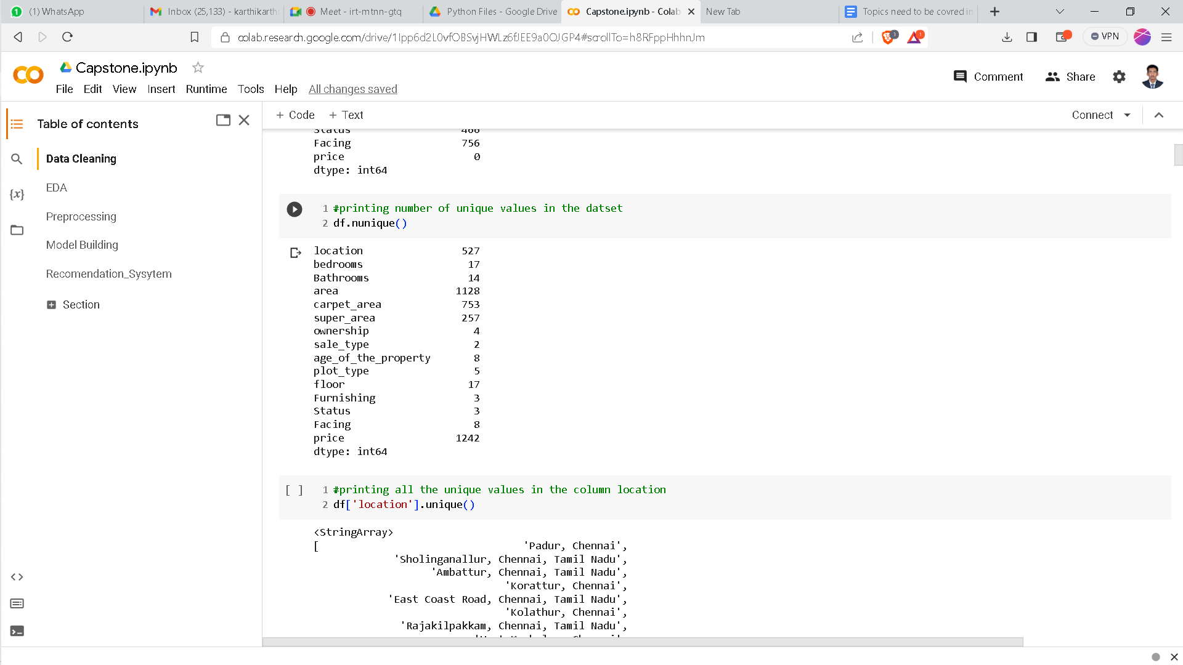
Data Exploration
Initial statistics :

Slide 8
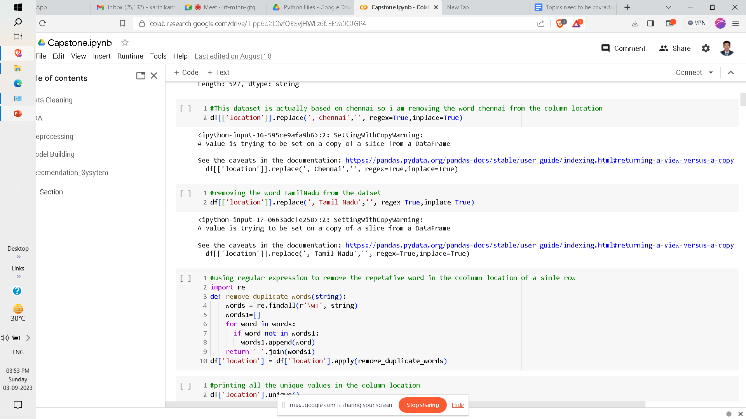
Data Cleaning
Cleaning the column location

Slide 9
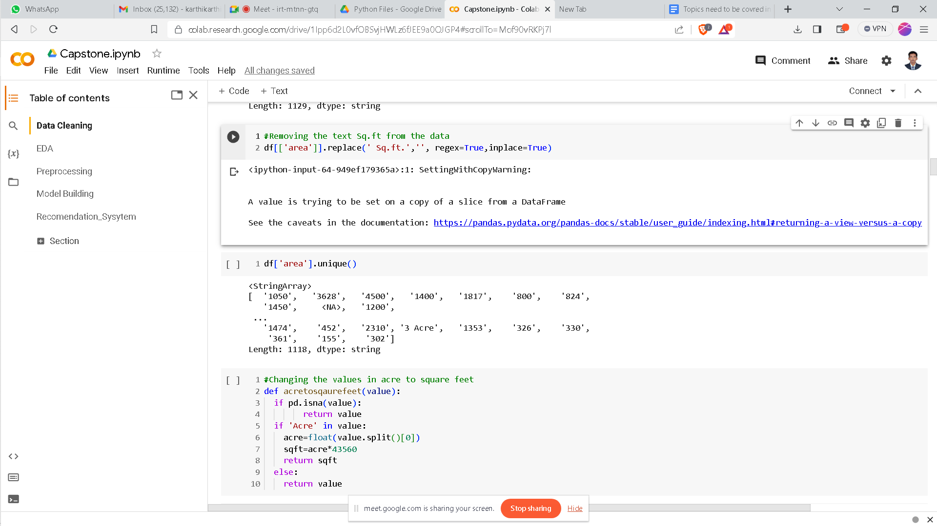
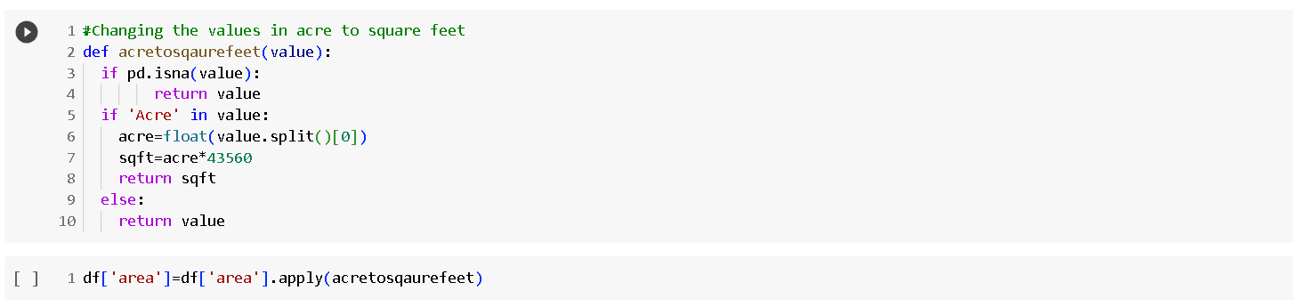
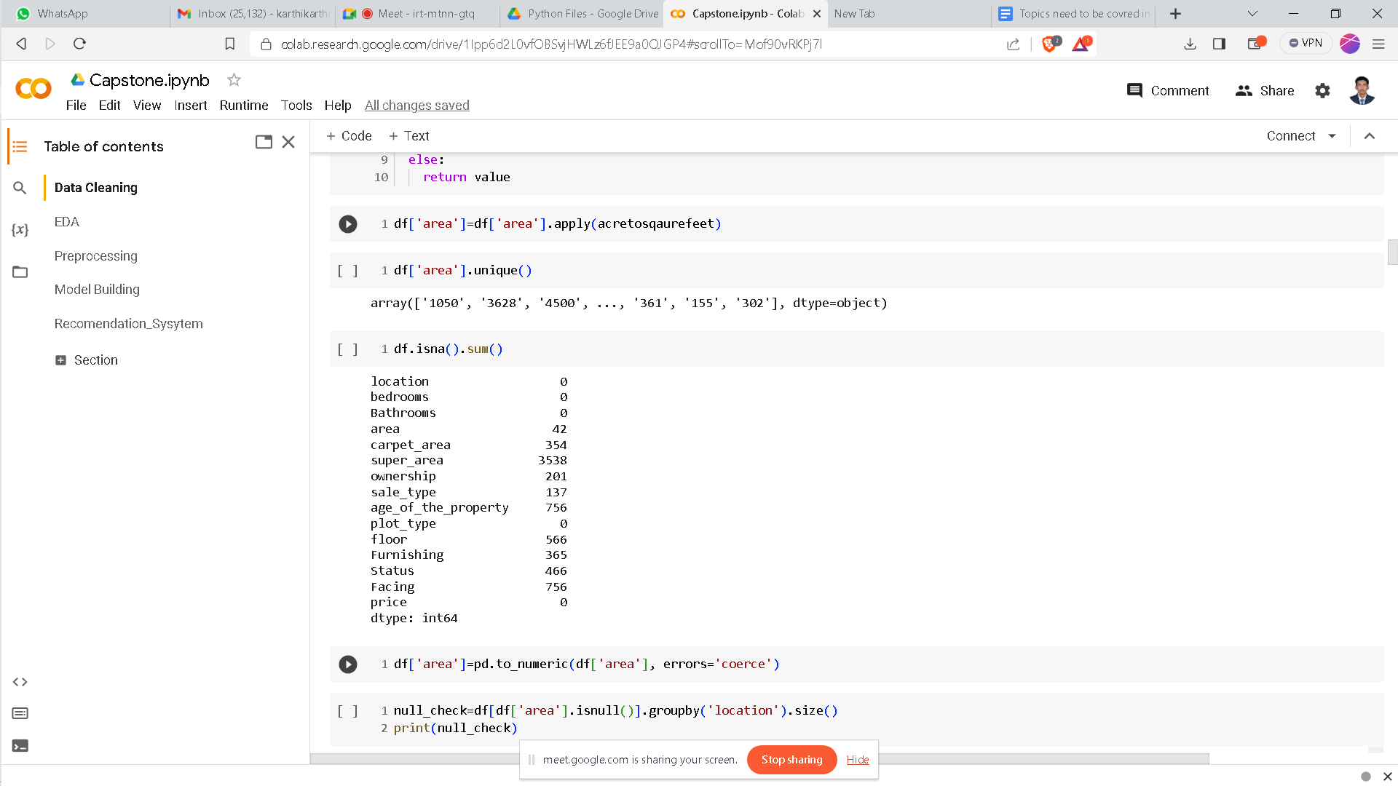
Data Cleaning
Cleaning the column area.

Slide 10
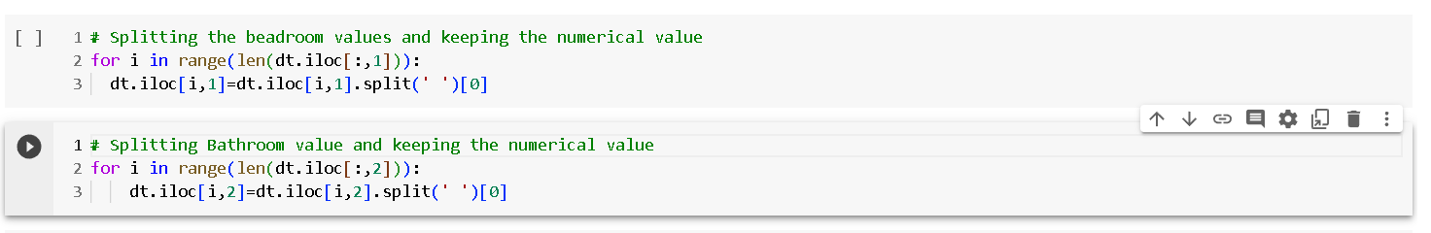
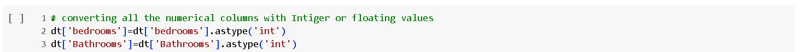
Data Cleaning
Cleaning the Columns Bedrooms and Bathrooms

Slide 11
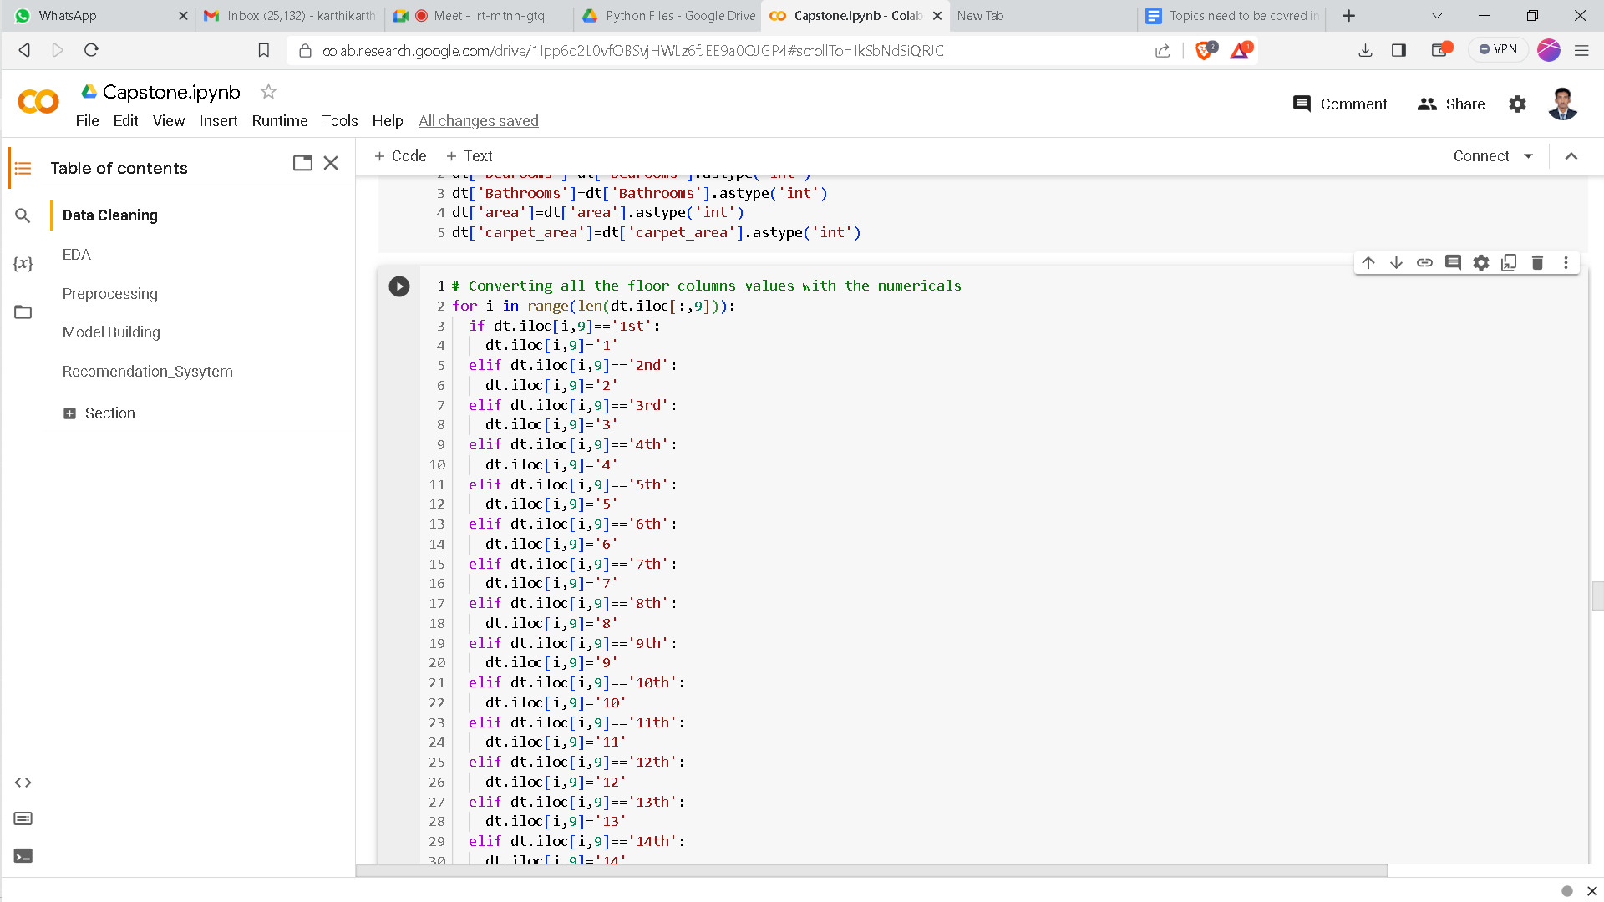
Data Cleaning
Cleaning the Column Floor.

Slide 12
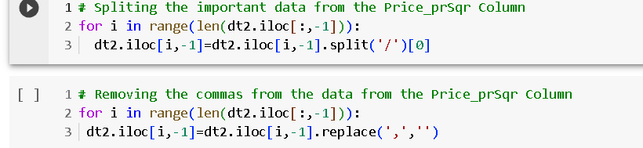
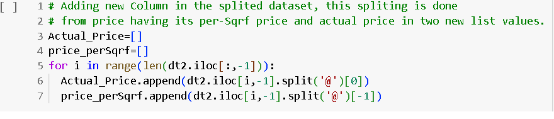
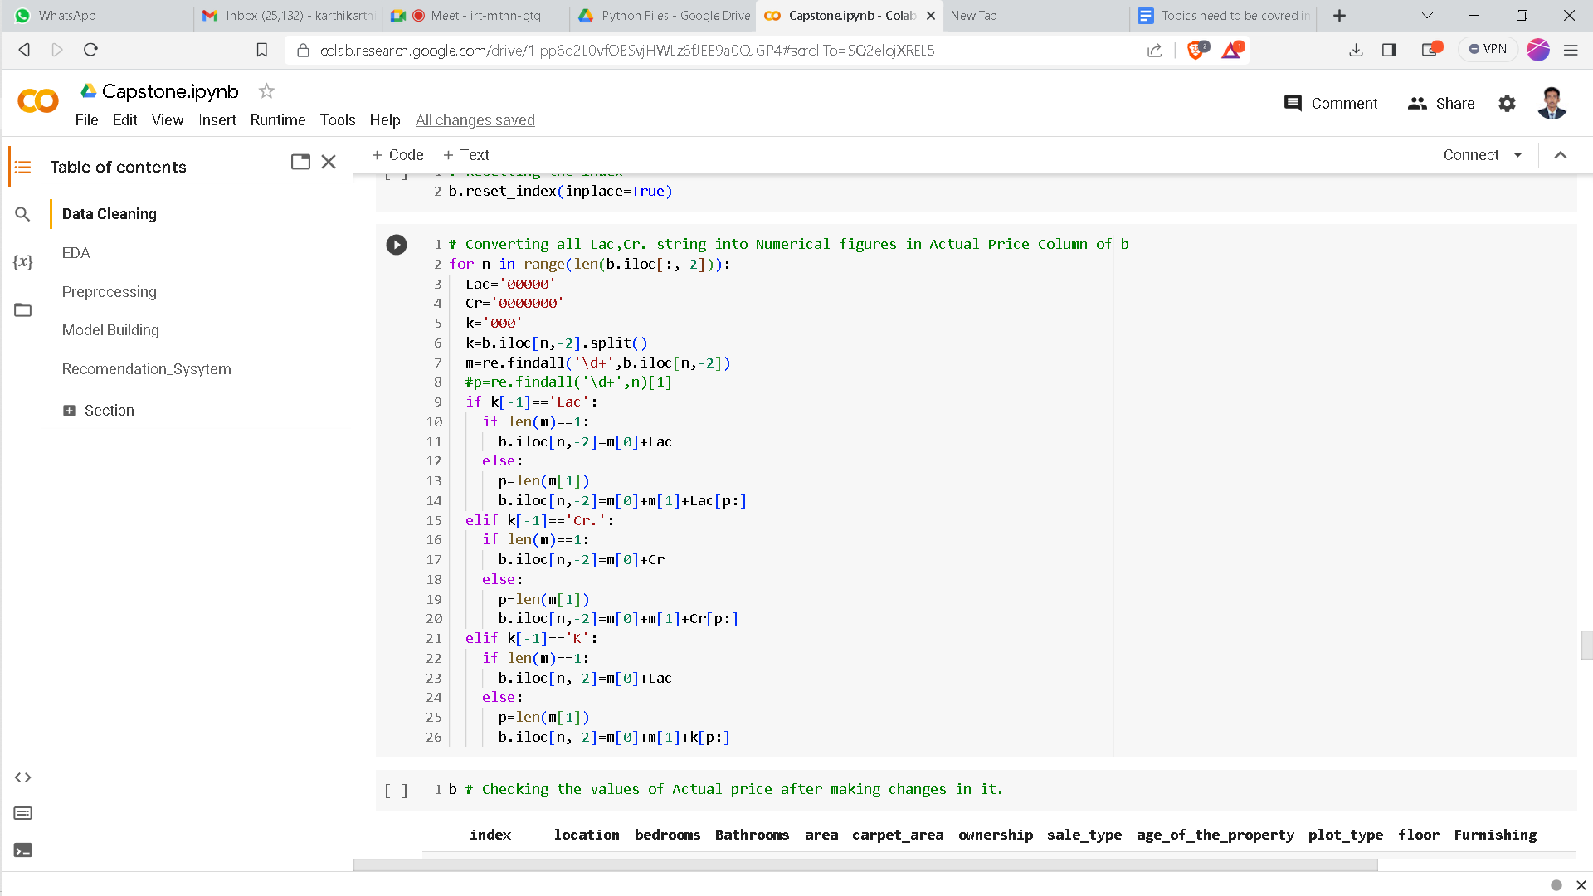
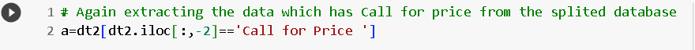
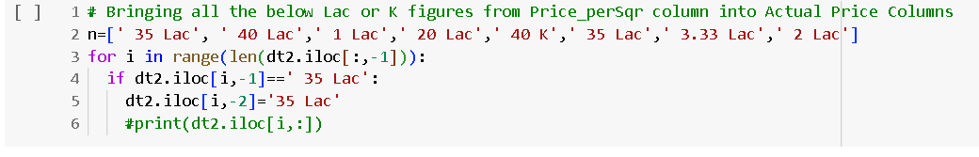
Data Cleaning
Cleaning the Column price.

Slide 13
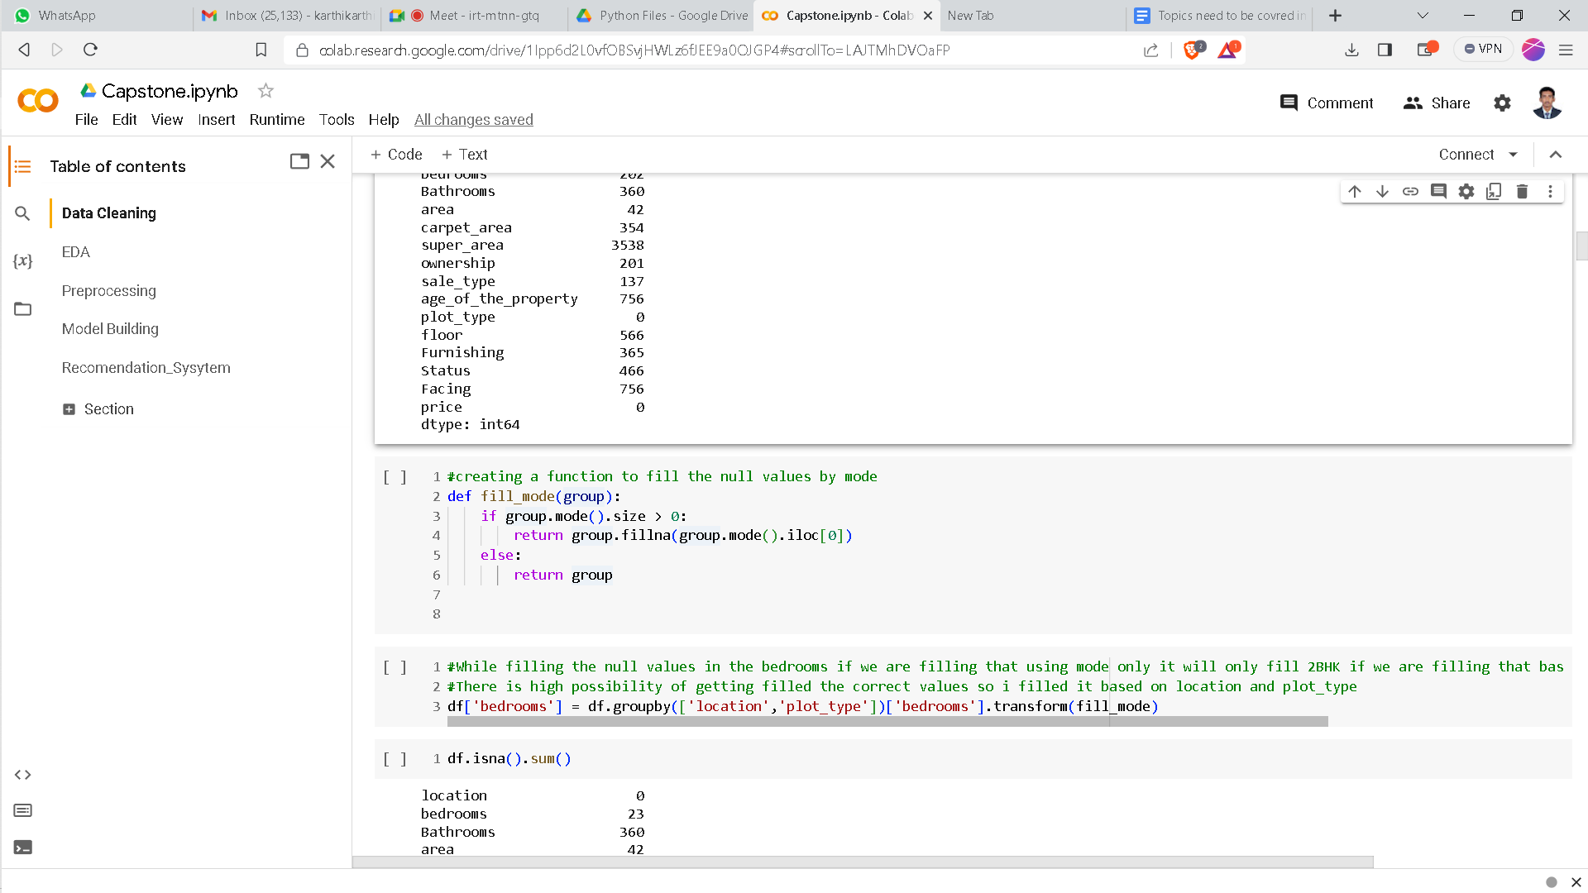
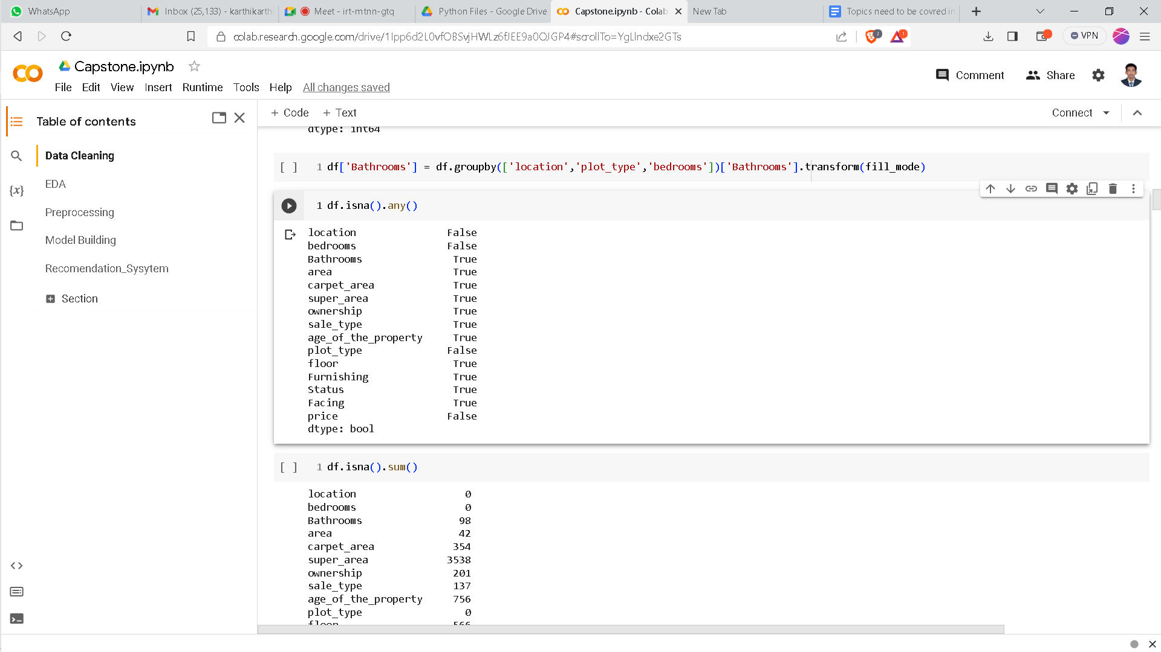
Data Cleaning
Filling the null values for categorical column using mode based on other features.
For Example if we are filling for bathrooms.

Slide 14
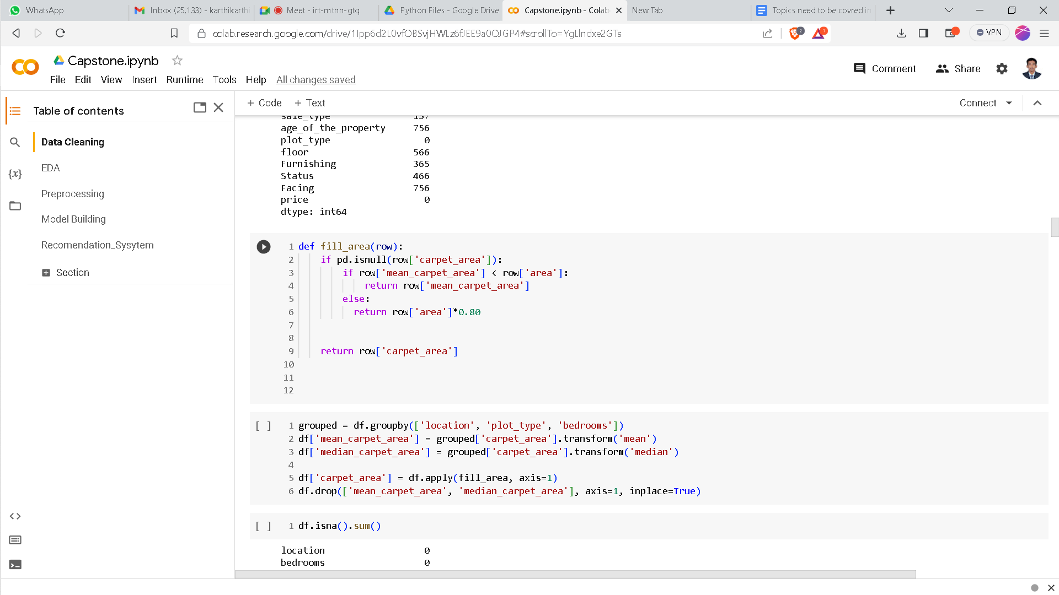
Data Cleaning
Filling null values for numerical values using mean based on different features.
Example for filling the null values for carpet area

Slide 15
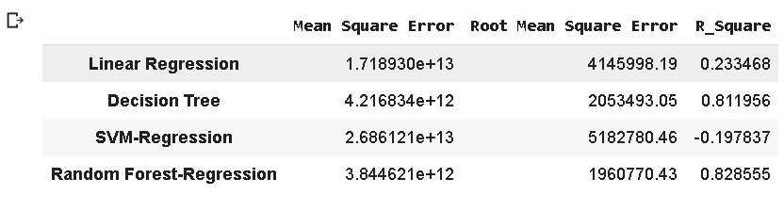
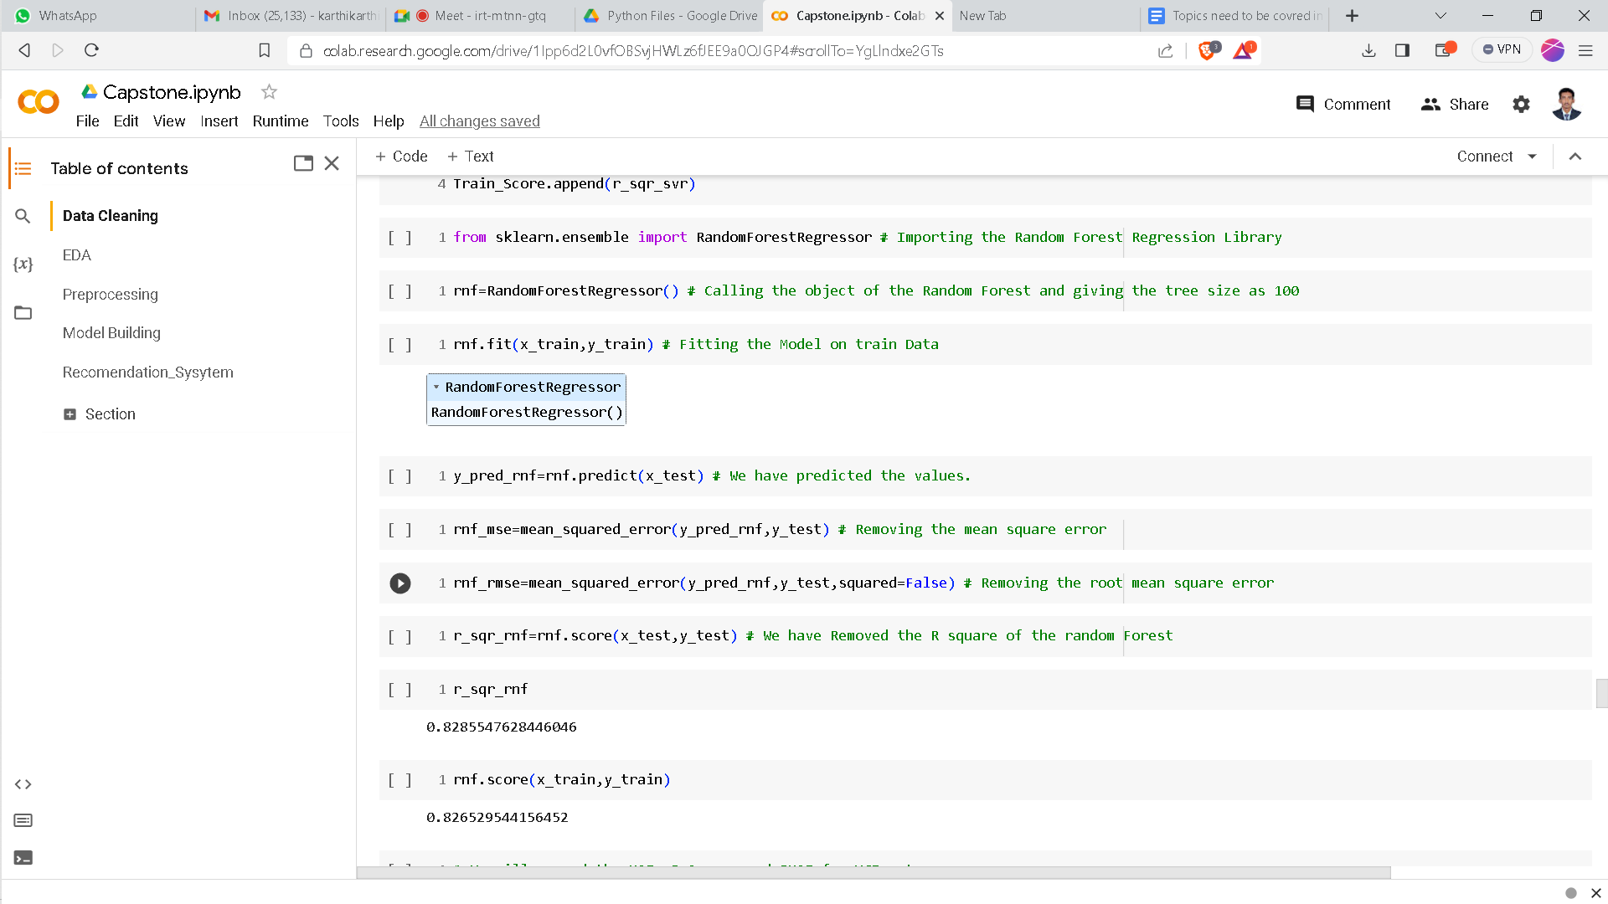
Data Cleaning
Filling null values for price column.
We have filled the null values by creating the model.
Among these models random forest is giving good accuracy so we have used random forest to fill the null values of prices.

Slide 16
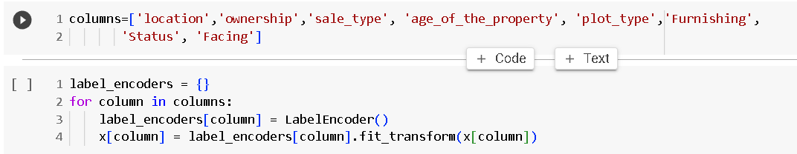
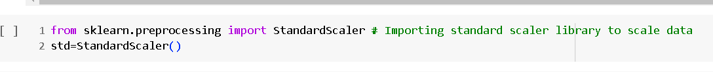
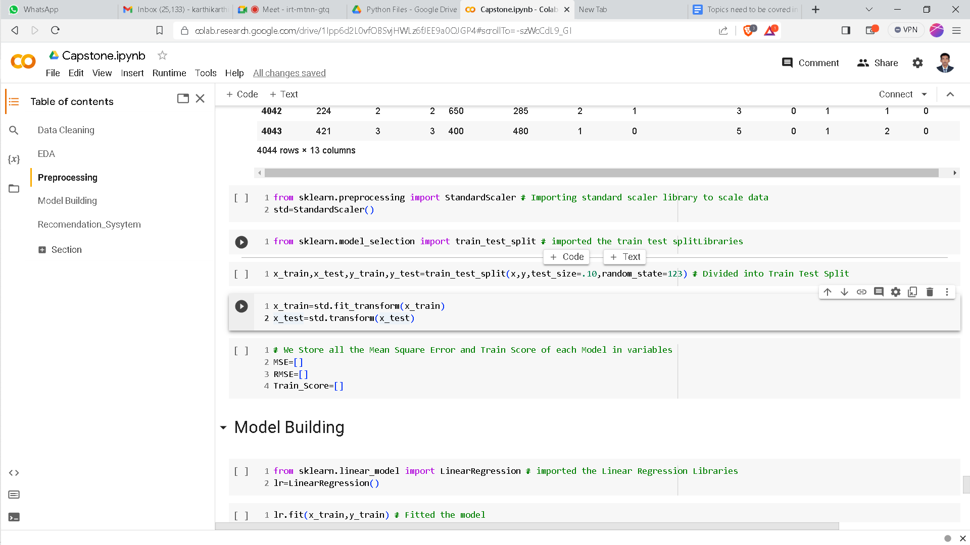
Data Cleaning
Label encoding the required columns.
Standardization of the features.

Slide 17
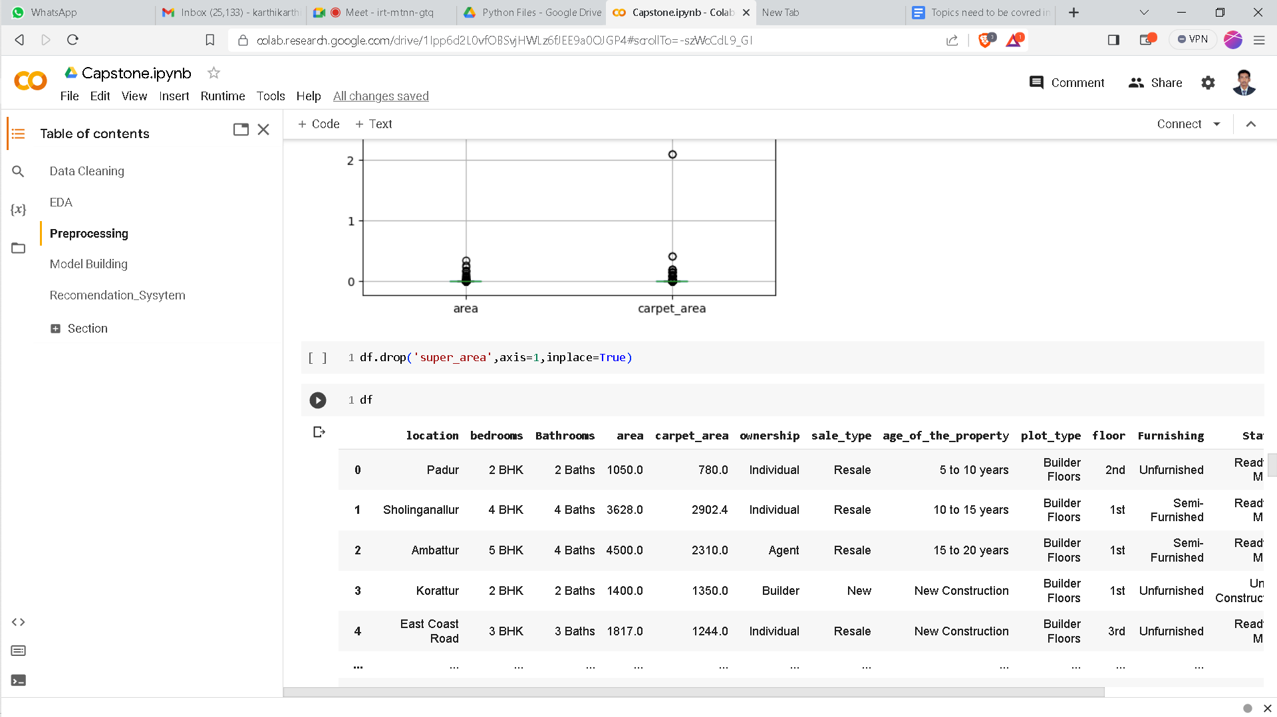
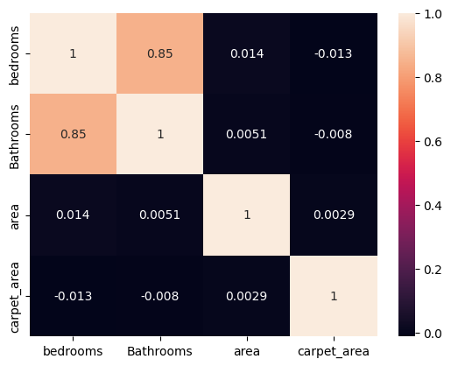
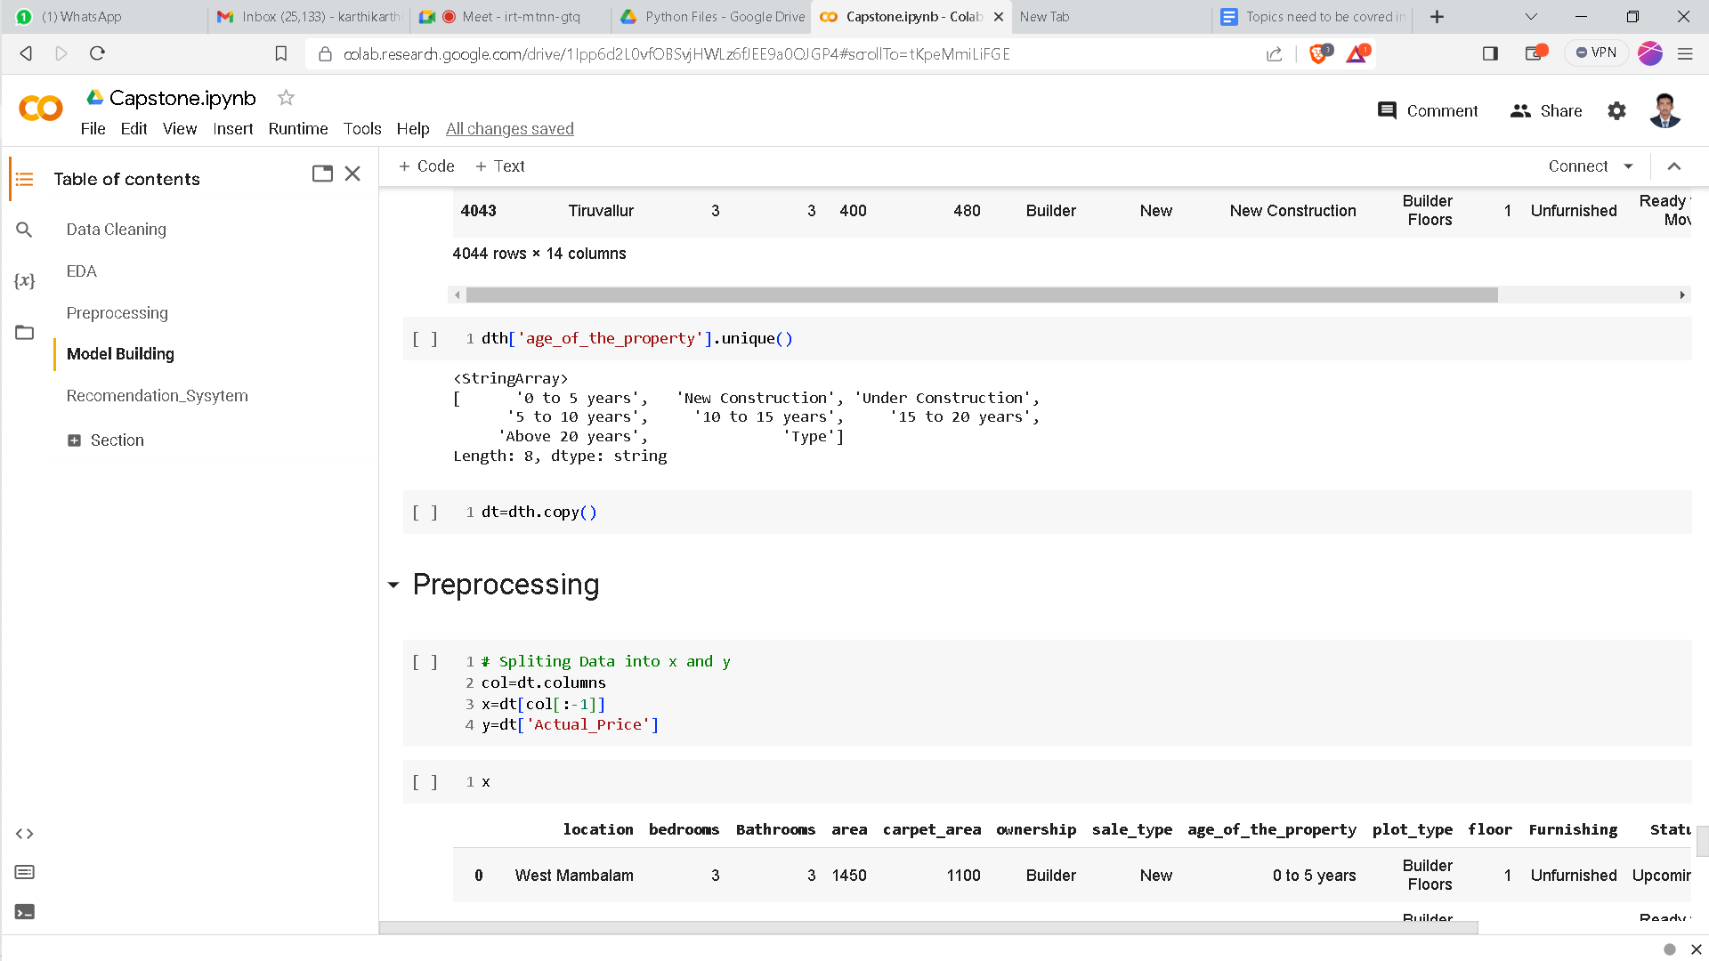
Feature Engineering & Selection:
We have selected the all the features except the super area because in super area we are having more than 70% of null values in it.so we decided to drop the column super area.
Based on the correlation we have selected all the features because there is no such correlation.

Slide 18
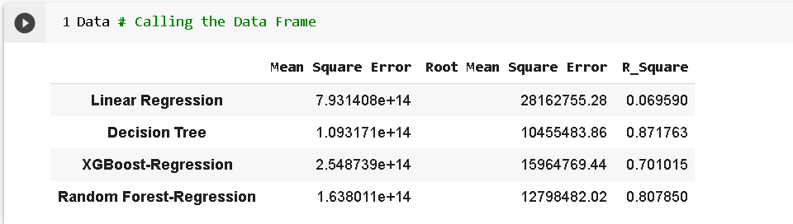
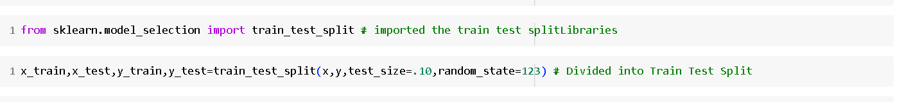
Modelling
Choice of Model(s):we choose the Decision tree model because it is giving the 87.17% of accuracy than the other algorithms.
Train Test Splitting:

Slide 19
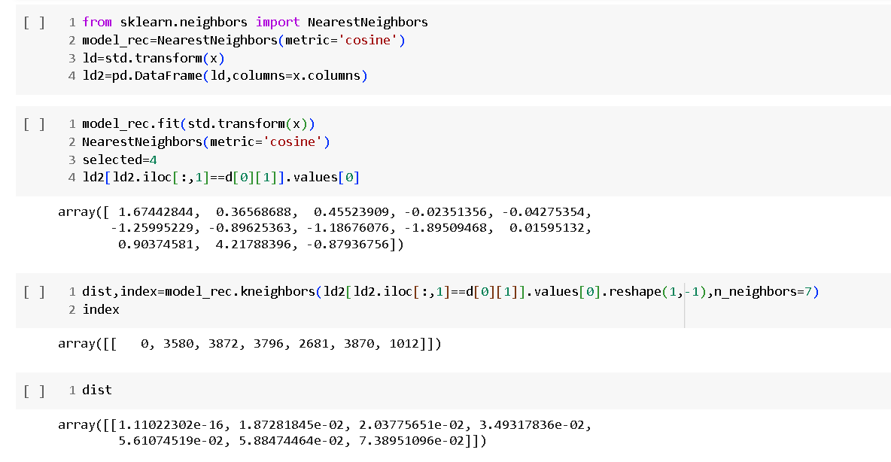
Modelling
Created a model for Content based Recommendation system based on the values we are filling to predict the price.

Slide 20
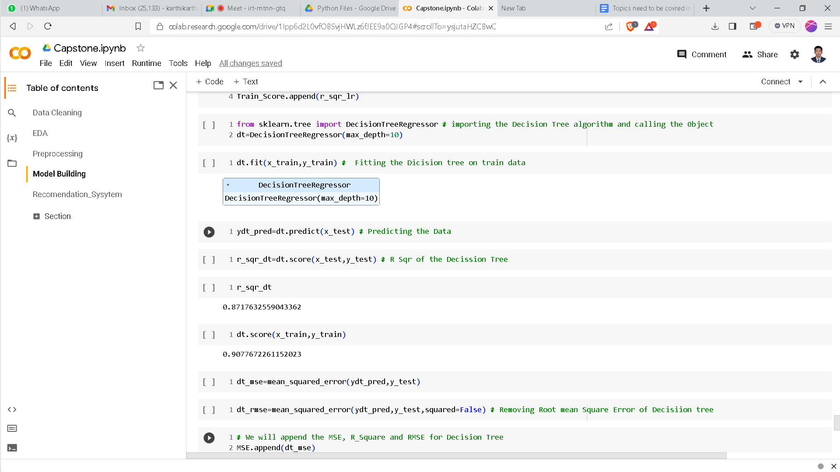
Modelling and Evaluation
Creation of Model for prediction

Slide 21
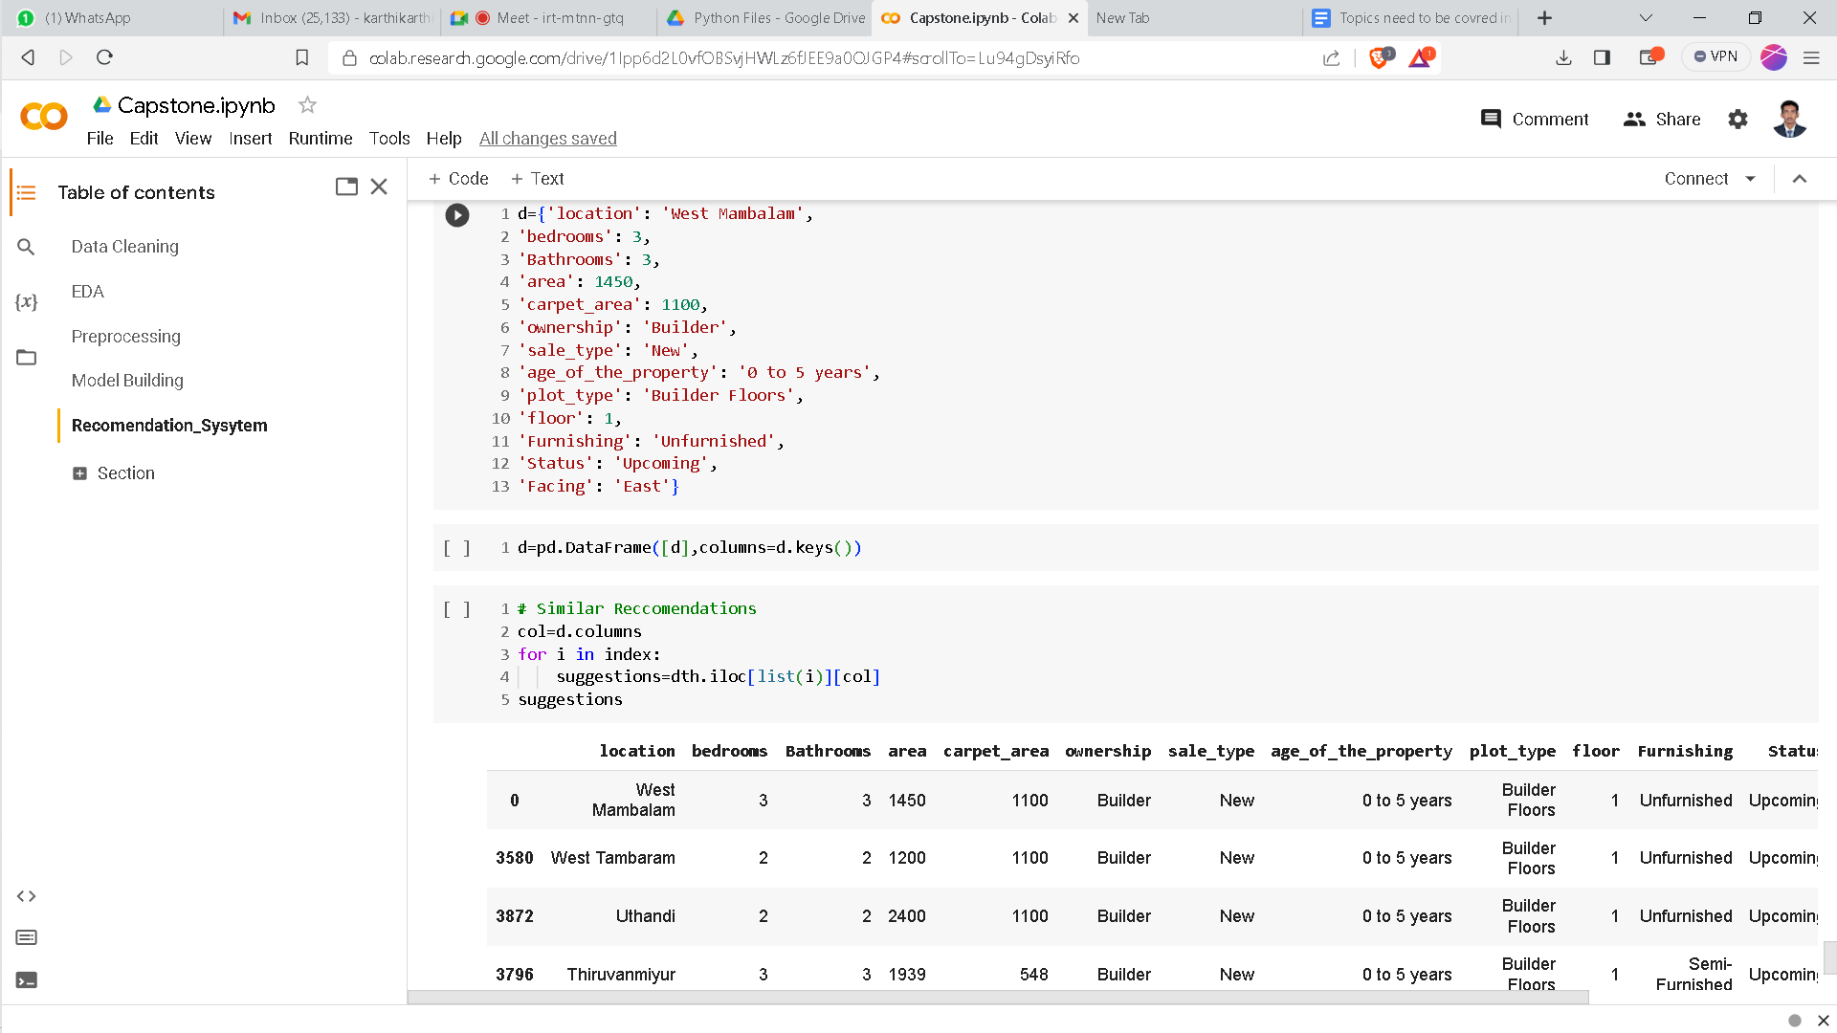
Model Evaluation
Evaluation of model for recommendation system.

Slide 22
Results & Insights
Chennai property prices are heavily influenced by the location, with prime areas commanding higher prices
The balance between housing supply and demand is a crucial factor in price fluctuations.
Property characteristics like size, amenities, facing and condition significantly impact prices.

Slide 23
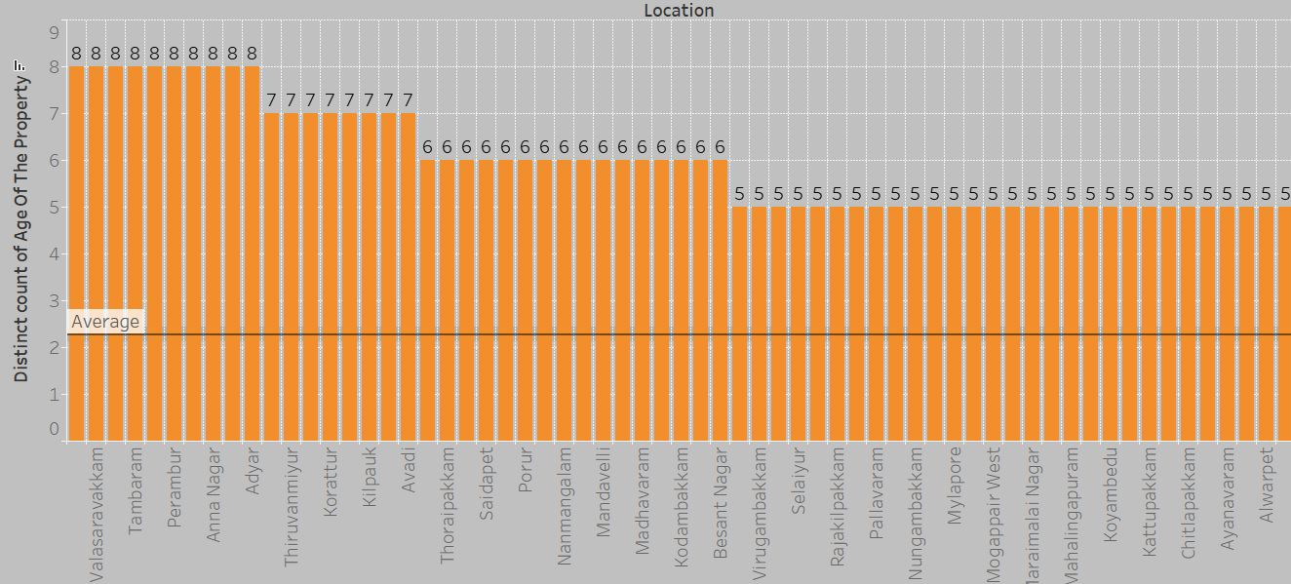
Visualizations
Analyzing age vs property location.

Slide 24
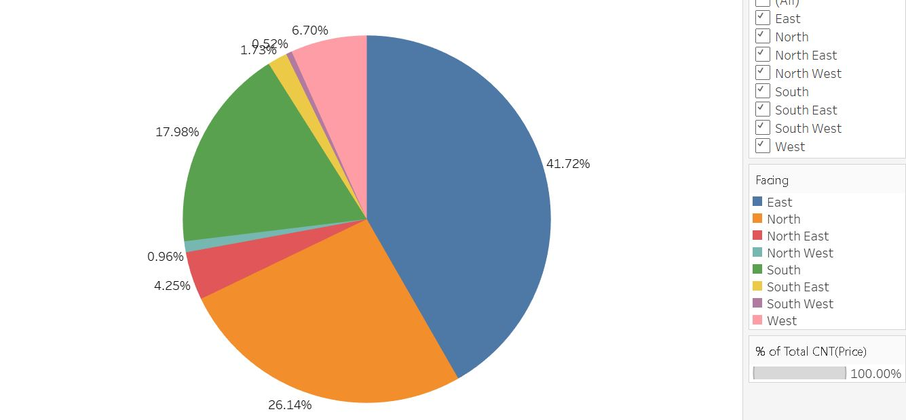
Visualizations
Analyzing like hood facing of the property.

Slide 25
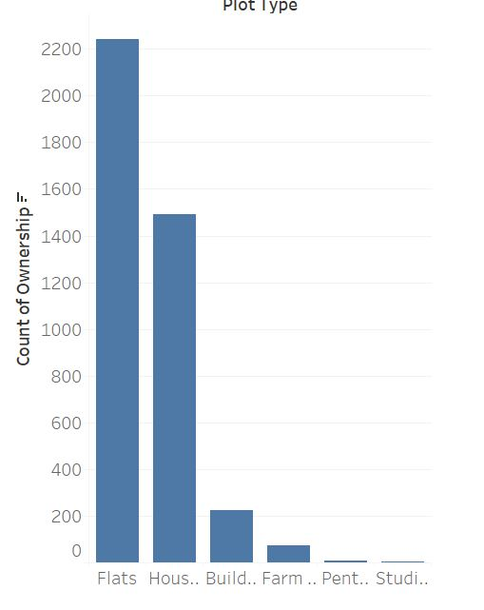
Visualizations
Analyzing preference of clients while purchasing house.

Slide 26
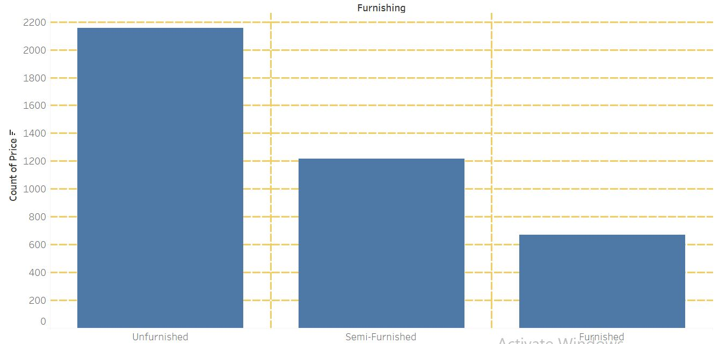
Visualizations
Analyzing client’s while choosing flat furnishing status.

Slide 27
Deployment
Preparation and Security: Define objectives, choose a model, preprocess data, and ensure security measures.
Deployment Environment: Select the deployment environment, create an API, and manage scalability.
Monitoring and Maintenance: Continuously monitor performance, update the model, and provide comprehensive documentation.

Slide 28
Deployment
Local Deployment: I began by setting up my Flask project on my local development machine. This allowed me to build and test the application in a controlled environment.
Global Deployment with AWS EC2: To make my project accessible to a wider audience, I deployed it on an Amazon Web Services (AWS) Elastic Compute Cloud (EC2) instance. This global deployment enabled users from around the world to access and interact with my application.

Slide 29
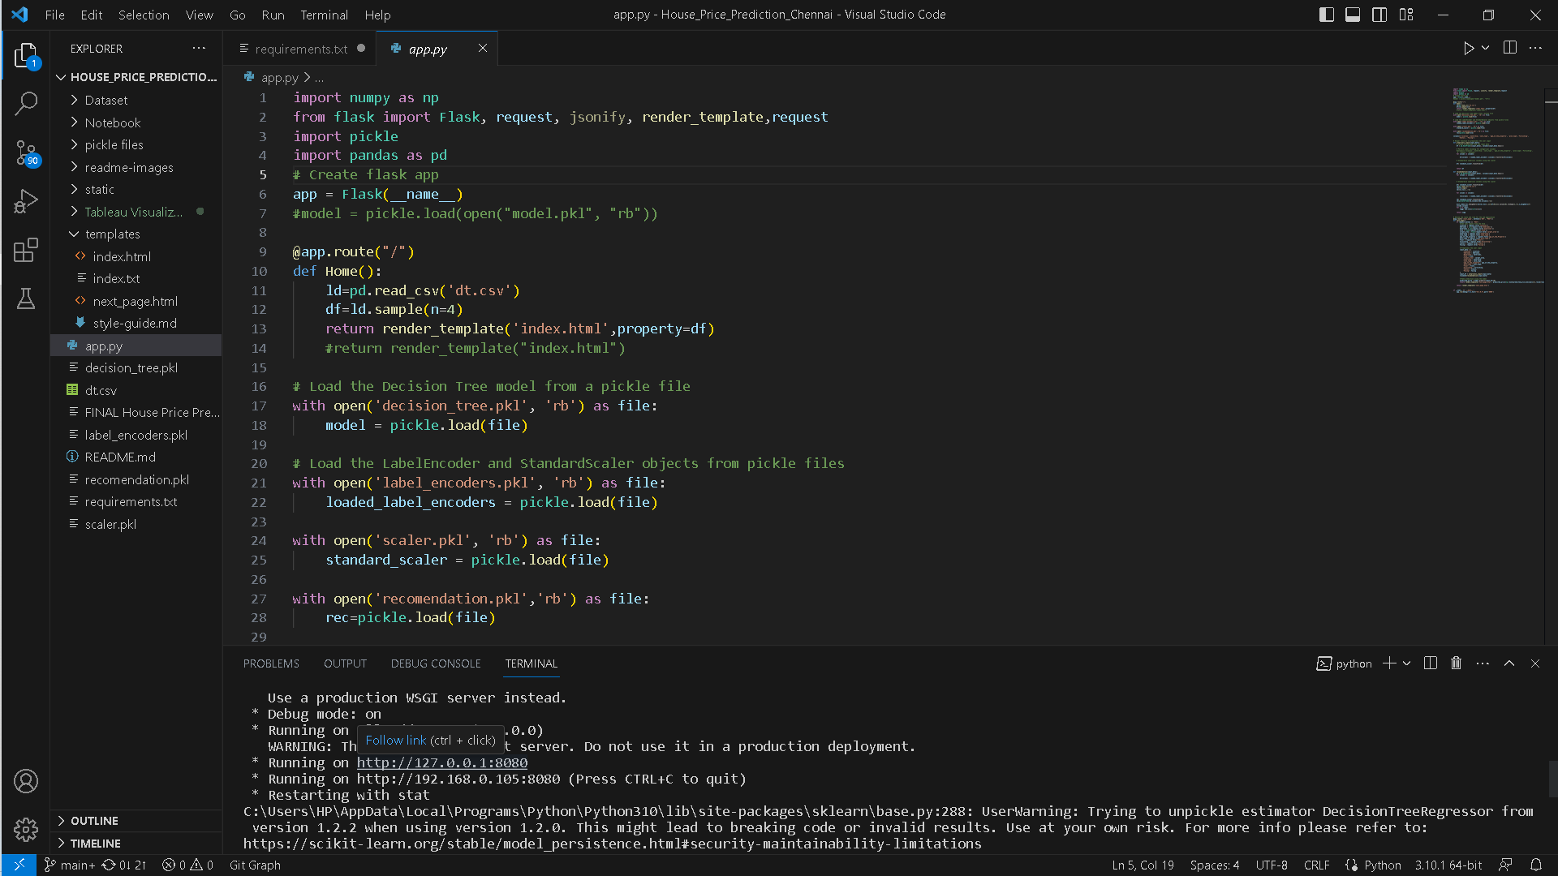
Local Deployment

Slide 30

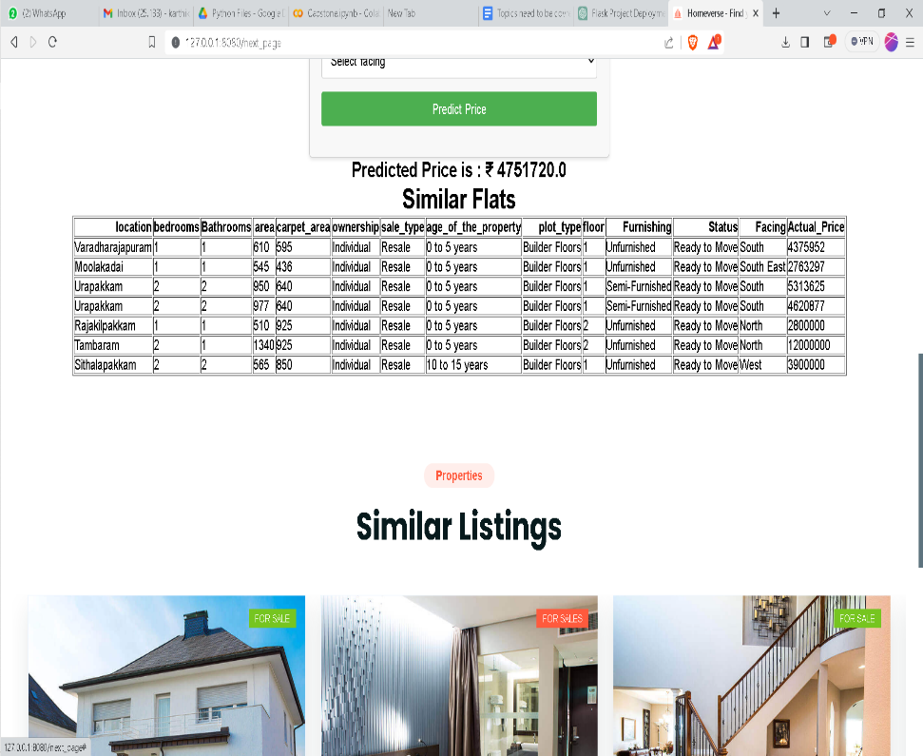
Local Deployment

Slide 31
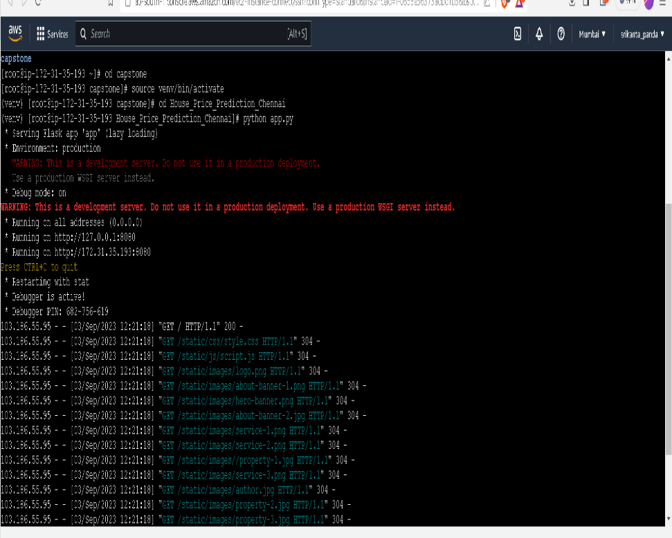

Global Deployment

Slide 32
Challenges
Challenges related to data collection, such as incomplete or missing data,inaccuracies in the dataset.
Difficulties in engineering meaningful features from the dataset, especially when dealing with real estate data that may have numerous variables.
Challenge of making the machine learning model's predictions and insights understandable and actionable for stakeholders, including non-technical audiences.

Slide 33
Learnings
Chennai's dynamic real estate market underscores the need for precise house price predictions, aiding informed investment decisions.
Leveraging crucial data sources, such as location, size, amenities, and historical prices, empowers our predictive model.
Employing a Decision Tree Regression algorithm, we achieve an impressive 87.13% accuracy in house price prediction.
Our project not only demonstrates the power of data-driven predictions but also equips investors to make well-informed choices in Chennai's real estate market.

Slide 34
Conclusion
Our project successfully utilizes data and machine learning to predict Chennai house prices with an impressive 87.13% accuracy.
These predictions provide valuable insights for prospective buyers and investors in Chennai's dynamic real estate market.
Understanding the significance of features like location, size, and amenities empowers stakeholders to make informed choices.
This work lays the foundation for further improvements and advancements in house price prediction, enhancing decision-making in Chennai's real estate sector.

Slide 35
Any Queries
Thank you

